Slide 1
Catching Worms, Trojan Horses and PUPs: Unsupervised Detection of Silent Delivery Campaigns
Bum Jun Kwon, Virinchi Srinivas,
Amol Deshpande, Tudor Dumitras
-University of Maryland
NDSS’17, San Diego, California, USA
Notes:
NDSS(Network & Distributed System Security)
Bum Jun Kwon, Tudor Dumitras
Department of Electrical & Computer Engineering
Virinchi Srinivas, Amol Deshpande CS

Slide 2
Outline
Background
Lockstep Behavior
Beewolf
Evaluation
Conclusion

Slide 3
Background
The growing commoditization of the underground economy has given rise to malware delivery networks
which charge fees for quickly delivering malware or unwanted software to a large number of hosts.
Understanding these campaigns can provide new insights into the malware landscape.
For example, the ability to measure the duration of such campaigns would reveal which malware families remain active and which are likely to stop propagating.
Notes:
A key method to provide this service is through the orchestration of silent delivery campaigns. These campaigns involve a group of downloaders that receive remote commands and then deliver their payloads without any user interaction. These campaigns can evade detection by relying on inconspicuous downloaders on the client side and on disposable domain names on the server side.
Additionally, by tracking the downloaders and the domain names associated with each malware delivery campaign, and the malware payloads disseminated, we could infer the business relationships from the underground economy

Slide 4
Background
Malware delivery networks
Inject downloaders in host
Downloaders access domain
Domain delivers payloads to host
through downloaders
Downloaders
Host
Notes:
A key method to provide this service is through the orchestration of silent delivery campaigns. These campaigns involve a group of downloaders that receive remote commands and then deliver their payloads without any user interaction. These campaigns can evade detection by relying on inconspicuous downloaders on the client side and on disposable domain names on the server side.

Slide 5
Background
Malware delivery networks
Inject downloaerds in host
Downloaders access domain
Domain delivers payloads to host
through downloaders
Downloaders
DNS Domain
Host
Notes:
A key method to provide this service is through the orchestration of silent delivery campaigns. These campaigns involve a group of downloaders that receive remote commands and then deliver their payloads without any user interaction. These campaigns can evade detection by relying on inconspicuous downloaders on the client side and on disposable domain names on the server side.

Slide 6
Background
Malware delivery networks
Inject downloaerds in host
Downloaders access domain
Domain delivers payloads to host
through downloaders
Payloads
Downloaders
DNS Domain
Host
Notes:
A key method to provide this service is through the orchestration of silent delivery campaigns. These campaigns involve a group of downloaders that receive remote commands and then deliver their payloads without any user interaction. These campaigns can evade detection by relying on inconspicuous downloaders on the client side and on disposable domain names on the server side.

Slide 7
Background
A key method to provide malware delivery service is through the orchestration of silent delivery campaigns
which involve a group of downloaders that receive remote commands and then download their pay loads with no user interaction.
These campaigns are attractive to the organizations that disseminate malware or potentially unwanted programs (PUPs), as they can evade detection by utilizing inconspicuous downloaders to retrieve the payloads, and disposable domain names to host and serve it temporarily.
Notes:
A key method to provide this service is through the orchestration of silent delivery campaigns. These campaigns involve a group of downloaders that receive remote commands and then deliver their payloads without any user interaction. These campaigns can evade detection by relying on inconspicuous downloaders on the client side and on disposable domain names on the server side.

Slide 8
Background
Silent delivery campaigns
Downloaders
DNS Domain
d_manager.exe
2013-11-15
Ppdownload.com
Host1
smart.exe
Host2
d_manager2.exe
Host3
Notes:
A key method to provide this service is through the orchestration of silent delivery campaigns. These campaigns involve a group of downloaders that receive remote commands and then deliver their payloads without any user interaction. These campaigns can evade detection by relying on inconspicuous downloaders on the client side and on disposable domain names on the server side.

Slide 9
Background
Silent delivery campaigns
Payloads
Downloaders
DNS Domain
d_manager.exe
2013-11-15
Ppdownload.com
Host1
Downloaders across hosts access the same domain within a short time window and deliver payloads.
smart.exe
Host2
d_manager2.exe
Host3
Notes:
A key method to provide this service is through the orchestration of silent delivery campaigns. These campaigns involve a group of downloaders that receive remote commands and then deliver their payloads without any user interaction. These campaigns can evade detection by relying on inconspicuous downloaders on the client side and on disposable domain names on the server side.

Slide 10
Background
Silent delivery campaigns
Payloads
Downloaders
DNS Domain
d_manager.exe
2013-11-15
Ppdownload.com
Host1
After a few days, downloaders across hosts access the ohter domain within a short time window and deliver payloads.
2013-11-22
greatarcadehits.com
smart.exe
Host2
d_manager2.exe
Host3
Notes:
A key method to provide this service is through the orchestration of silent delivery campaigns. These campaigns involve a group of downloaders that receive remote commands and then deliver their payloads without any user interaction. These campaigns can evade detection by relying on inconspicuous downloaders on the client side and on disposable domain names on the server side.

Slide 11
Background
Silent delivery campaigns
Payloads
Downloaders
DNS Domain
d_manager.exe
2013-11-15
Ppdownload.com
Host1
After a few days, downloaders across hosts access the ohter domain within a short time window and deliver payloads.
2013-11-22
greatarcadehits.com
smart.exe
Host2
2013-12-05
download2desktop.com
d_manager2.exe
Host3
Notes:
A key method to provide this service is through the orchestration of silent delivery campaigns. These campaigns involve a group of downloaders that receive remote commands and then deliver their payloads without any user interaction. These campaigns can evade detection by relying on inconspicuous downloaders on the client side and on disposable domain names on the server side.

Slide 12
Background
Silent delivery campaigns
Payloads
Downloaders
DNS Domain
d_manager.exe
2013-11-15
Ppdownload.com
Host1
These are coordinated actions among these downloaders and domains.
2013-11-22
greatarcadehits.com
smart.exe
Host2
2013-12-05
download2desktop.com
d_manager2.exe
Host3
Notes:
A key method to provide this service is through the orchestration of silent delivery campaigns. These campaigns involve a group of downloaders that receive remote commands and then deliver their payloads without any user interaction. These campaigns can evade detection by relying on inconspicuous downloaders on the client side and on disposable domain names on the server side.

Slide 13
Background
Silent delivery campaigns
Payloads
Downloaders
DNS Domain
d_manager.exe
2013-11-15
Ppdownload.com
Host1
Identify malicious domains (using machine leraning
techniques)
[Antonakakis+ 2010]
Previous studies:
2013-11-22
greatarcadehits.com
Detect malicious downloaders on the client side
[Kwon+ 2015]
smart.exe
Host2
2013-12-05
download2desktop.com
d_manager2.exe
Host3
Malware families disseminated
[Inverizzi+ 2014]
Milk PUP payloads
[Caballero+ 2011, Thomas+ 2016]
Notes:
A key method to provide this service is through the orchestration of silent delivery campaigns. These campaigns involve a group of downloaders that receive remote commands and then deliver their payloads without any user interaction. These campaigns can evade detection by relying on inconspicuous downloaders on the client side and on disposable domain names on the server side.

Slide 14
Outline
Background
Lockstep Behavior
Beewolf
Cooperative Semantic Recognition(CSR)
Implementation
Evaluation
Conclusion

Slide 15
Lockstep Behavior
Previous Studies:
Downloaders
DNS Domain
[Beutel+ 2013, Cao+ 2014, Jiang+ 2015 ]
Have some limitations:
Require seed nodes
Require interpreting events defined by multiple features
Not designed for streaming data
Notes:
A key method to provide this service is through the orchestration of silent delivery campaigns. These campaigns involve a group of downloaders that receive remote commands and then deliver their payloads without any user interaction. These campaigns can evade detection by relying on inconspicuous downloaders on the client side and on disposable domain names on the server side.

Slide 16
Lockstep Behavior
Downloaders
DNS Domain
Understanding the indirect relationship between downloaders can expose hidden dependencies in the underground economy.
Notes:
A key method to provide this service is through the orchestration of silent delivery campaigns. These campaigns involve a group of downloaders that receive remote commands and then deliver their payloads without any user interaction. These campaigns can evade detection by relying on inconspicuous downloaders on the client side and on disposable domain names on the server side.

Slide 17
Lockstep Behavior
Downloaders
DNS Domain
Understanding the indirect relationship between downloaders can expose hidden dependencies in the underground economy.
Notes:
A key method to provide this service is through the orchestration of silent delivery campaigns. These campaigns involve a group of downloaders that receive remote commands and then deliver their payloads without any user interaction. These campaigns can evade detection by relying on inconspicuous downloaders on the client side and on disposable domain names on the server side.

Slide 18
Outline
Background
Lockstep Behavior
Beewolf
Evaluation
Conclusion

Slide 19
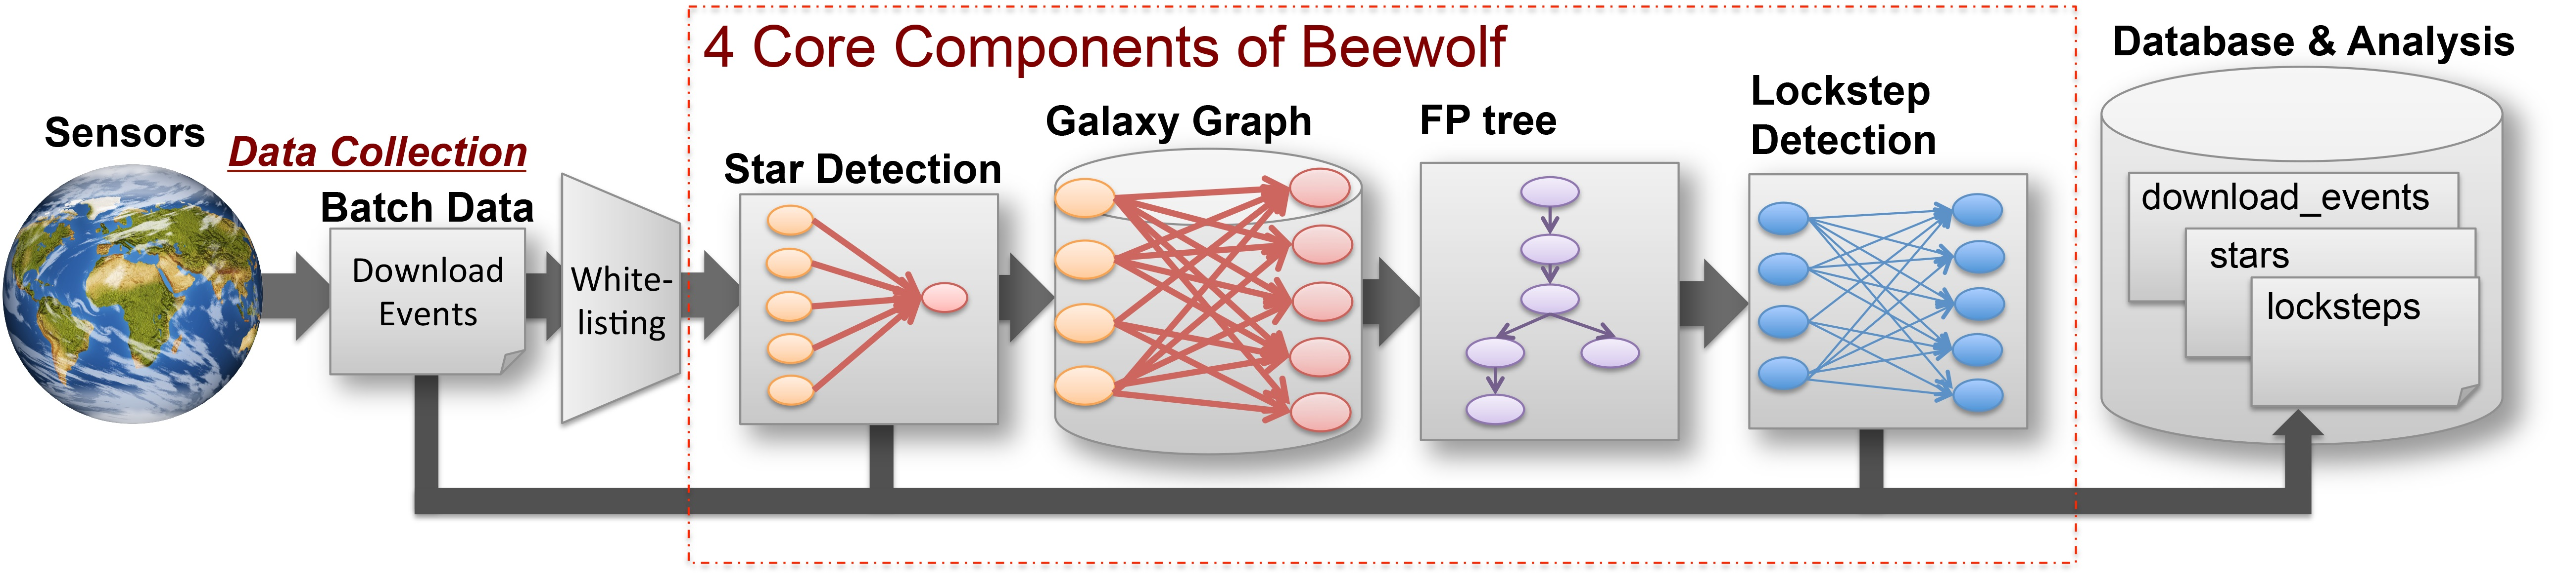
Beewolf-system overview
To detect lockstep
Input
Some benign domains
(ex: Windows update)
Data Source:
Lots of download events(from 2013)
Include:
SHA2 hash of downloader and payload,
Source domain of download,
Timestamp of the event
System Output:
Stars
Locksteps
Communities
Groups of intense connective domains & downloaders.
Notes:
A key method to provide this service is through the orchestration of silent delivery campaigns. These campaigns involve a group of downloaders that receive remote commands and then deliver their payloads without any user interaction. These campaigns can evade detection by relying on inconspicuous downloaders on the client side and on disposable domain names on the server side.

Slide 20
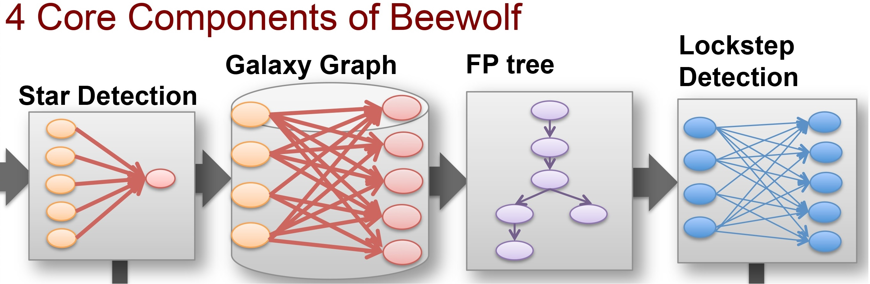
Beewolf-Bipartite Graph
名詞解釋
G = (U; V; E) where U and V are disjoint set of nodes corresponding to left hand nodes and right hand nodes, respectively, and an edge e ∈ E may link two nodes belonging to different sets but not nodes from the same set.
Downloaders
DNS Domain
U
E
V
Notes:
A key method to provide this service is through the orchestration of silent delivery campaigns. These campaigns involve a group of downloaders that receive remote commands and then deliver their payloads without any user interaction. These campaigns can evade detection by relying on inconspicuous downloaders on the client side and on disposable domain names on the server side.

Slide 21
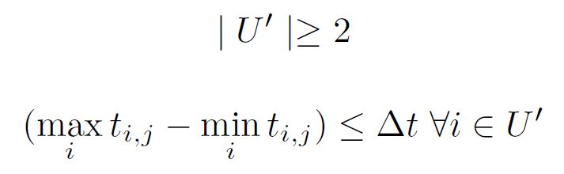
Beewolf-Star Detection
名詞解釋
G = (U; V; E) where U and V are disjoint set of nodes corresponding to left hand nodes and right hand nodes, respectively, and an edge e ∈ E may link two nodes belonging to different sets but not nodes from the same set.
A star
Downloaders
DNS Domain
名詞解釋:
Let t_{i,j} represent the time at which an edge is formed between node i ∈ U and node j ∈ V . Further, let U’⊆ U and V’ ⊆ V .
We define a star [U’; j; Δt; δt] on U’ and some central node j ∈ V’ as follows:
The above equations state that a star contains at least 2 left
hand nodes and the time difference between the addition of
the first and the last edge to the star is at most Δ t.
Notes:
A key method to provide this service is through the orchestration of silent delivery campaigns. These campaigns involve a group of downloaders that receive remote commands and then deliver their payloads without any user interaction. These campaigns can evade detection by relying on inconspicuous downloaders on the client side and on disposable domain names on the server side.

Slide 22
Beewolf-Galaxy Graph
Downloaders
DNS Domain
a
A
b
B
c
C
d
D
e
Notes:
A key method to provide this service is through the orchestration of silent delivery campaigns. These campaigns involve a group of downloaders that receive remote commands and then deliver their payloads without any user interaction. These campaigns can evade detection by relying on inconspicuous downloaders on the client side and on disposable domain names on the server side.

Slide 23
Beewolf- Frequent PatternTree
Downloaders
DNS Domain
a
A
root
B | c b a d
C | c b a e
A | c b a
D | c d e
B, C, A, D
b
B
c
B, C, A
D
b
d
c
C
B, C, A
a
e
C
e
D
d
D
B
d
e
Notes:
A key method to provide this service is through the orchestration of silent delivery campaigns. These campaigns involve a group of downloaders that receive remote commands and then deliver their payloads without any user interaction. These campaigns can evade detection by relying on inconspicuous downloaders on the client side and on disposable domain names on the server side.

Slide 24
Beewolf- Lockstep Detection
Downloaders
DNS Domain
a
A
Lockstep
root
B | c b a d
C | c b a e
A | c b a
D | c d e
B, C, A, D
b
B
c
B, C, A
D
b
d
c
C
B, C, A
a
e
C
e
D
d
D
B
d
e
Notes:
A key method to provide this service is through the orchestration of silent delivery campaigns. These campaigns involve a group of downloaders that receive remote commands and then deliver their payloads without any user interaction. These campaigns can evade detection by relying on inconspicuous downloaders on the client side and on disposable domain names on the server side.

Slide 25
Outline
Motivation & Goal
Lockstep Behavior
Beewolf
Evaluation
Conclusion

Slide 26
Evaluation
Beewolf in offline mode
Time window Δt of 3 days
Shorter than the typical reaction time of domain blacklist
Summary
Discover locksteps: 67,094
Notes:
A key method to provide this service is through the orchestration of silent delivery campaigns. These campaigns involve a group of downloaders that receive remote commands and then deliver their payloads without any user interaction. These campaigns can evade detection by relying on inconspicuous downloaders on the client side and on disposable domain names on the server side.

Slide 27
Evaluation
Label downloader by payload
Easier to do detection sperformance evaluation
First, label the downloader by the payload they distribute
Malware downloader(MD)
PUP downloader(PD)
Benign downloader(BD)
Unknown downloader(UD)
Notes:
A key method to provide this service is through the orchestration of silent delivery campaigns. These campaigns involve a group of downloaders that receive remote commands and then deliver their payloads without any user interaction. These campaigns can evade detection by relying on inconspicuous downloaders on the client side and on disposable domain names on the server side.

Slide 28
Evaluation
Label lockstep based on downloader labeling
Malware downloader lockstep(MDL):lockstep that include at least one MD
PUP downloader lockstep(PDL):contains PD but no MD
Unknown downloader lockstep(UDL):no suspicious downloader
Benign downloader lockstep(BDL):no suspicious downloader & contain BD
Notes:
A key method to provide this service is through the orchestration of silent delivery campaigns. These campaigns involve a group of downloaders that receive remote commands and then deliver their payloads without any user interaction. These campaigns can evade detection by relying on inconspicuous downloaders on the client side and on disposable domain names on the server side.

Slide 29
Evaluation
Success rate in labeling (only 2.33% UDLs)
MDL occupy more than 80% of the total lockstep while BDL are 4.82%
Notes:
A key method to provide this service is through the orchestration of silent delivery campaigns. These campaigns involve a group of downloaders that receive remote commands and then deliver their payloads without any user interaction. These campaigns can evade detection by relying on inconspicuous downloaders on the client side and on disposable domain names on the server side.

Slide 30
Evaluation
Overlap of downloaders
36.7% of the downloaders are present in both MDLs and PDLs
Associated with 97.8% of all the PDLS
Malsign blacklist
1,926 downloaders signed by 212 publishers in locksteps
Involved in 66.8% of MDLs and 37.2% of PDLs
PUP publishers are likely involved in malware delivery

Slide 31
Evaluation
Recent measurements of commercial Pay per install(PPI) [Kotzias+ 2016, Thomas+ 2016]
Did not find substantial overlap
Key distinction
Geographical distribution
(This study) Hosts from 72 different contries
Different observation period / malware set
Locksteps detect indirect relationships
Utilize unsigned downloaders for malicious payloads

Slide 32
Evaluation
Publishers appearing together in locksteps
Utilize the same server side infrastructure
Reflects a relationship among the corresponding distribution networks
Two different publisher relationships:
Partner: downloaders in downloaded-by relationship
Neighbor: No direct download relationship
Organization that uses multiple code signing certificate
Relationships with a common third party

Slide 33
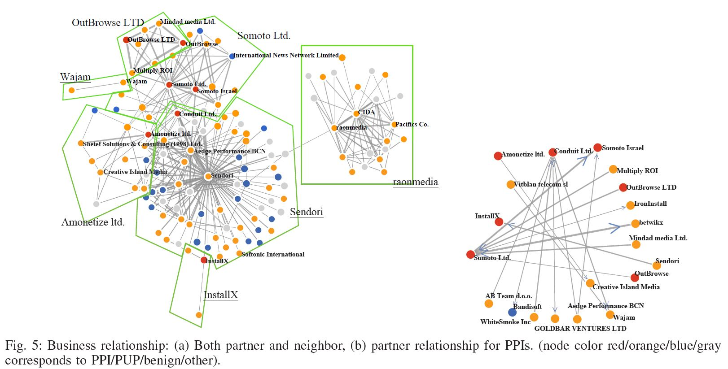
Evaluation

Slide 34
Outline
Motivation & Goal
Lockstep Behavior
Beewolf
Evaluation
Conclusion

Slide 35
Conclusion
Beewolf
Unsupervised and deterministic system, operates on stream of data
Discover indirect relationships(reflect PUP/malware overlap)
Future work
Detect other kinds of coordinated actions(Beaconing, C&C communication, posting in SNS)

